Slide 1
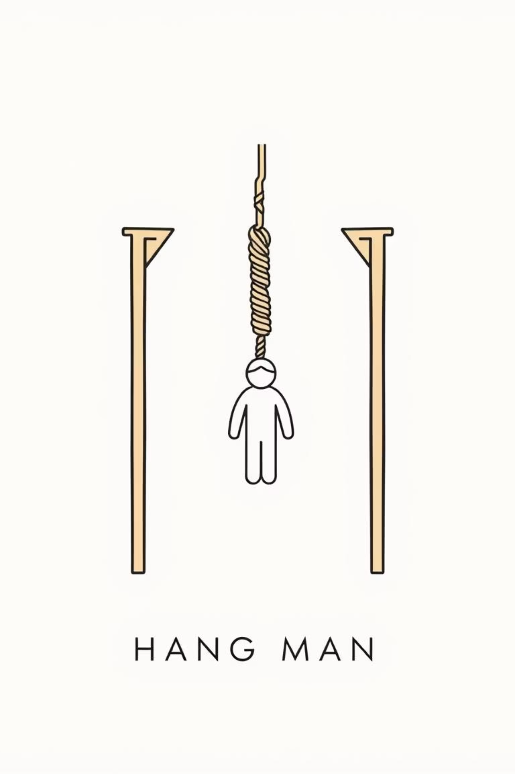
Hangman Game:
Dive into a “Word” of Adventure
By,
Group-3
Intisar Binthay Fauzul
Ashfaqul Alam
Syed Sadat Hasan
Rafiha Saleha
Group-3 | Members: Intisar Binthay Fauzul, Ashfaqul Alam, Syed Sadat Hasan, Rafiha Saleha

Slide 2
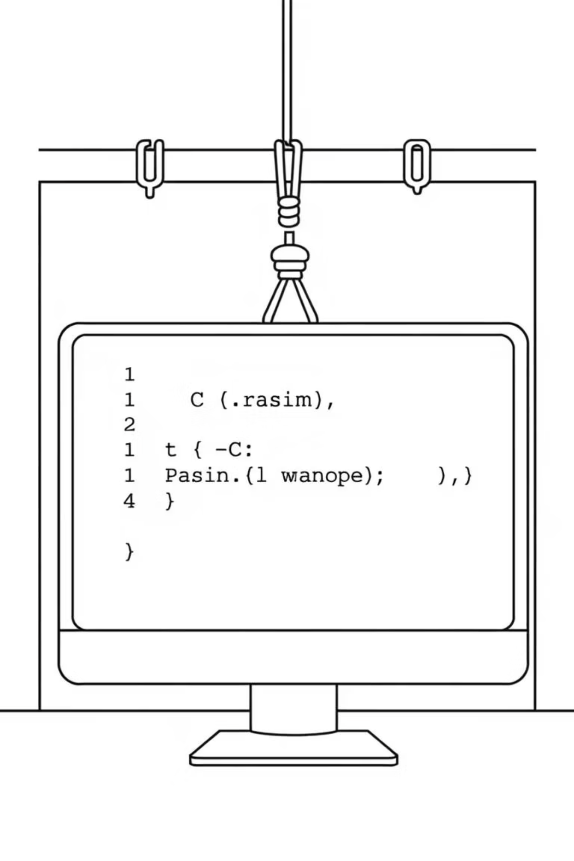
Project Overview
We made a new version of the classic Hangman game for your computer screen.
Core
1
The game chooses words smartly to keep it fun and interesting.
Easy to Use
2
Simple instructions and clear pictures make it easy for anyone to play.
Runs Well
3
The game is built in a way that makes it work smoothly and quickly.
Group-3 | Members: Intisar Binthay Fauzul, Ashfaqul Alam, Syed Sadat Hasan, Rafiha Saleha

Slide 3
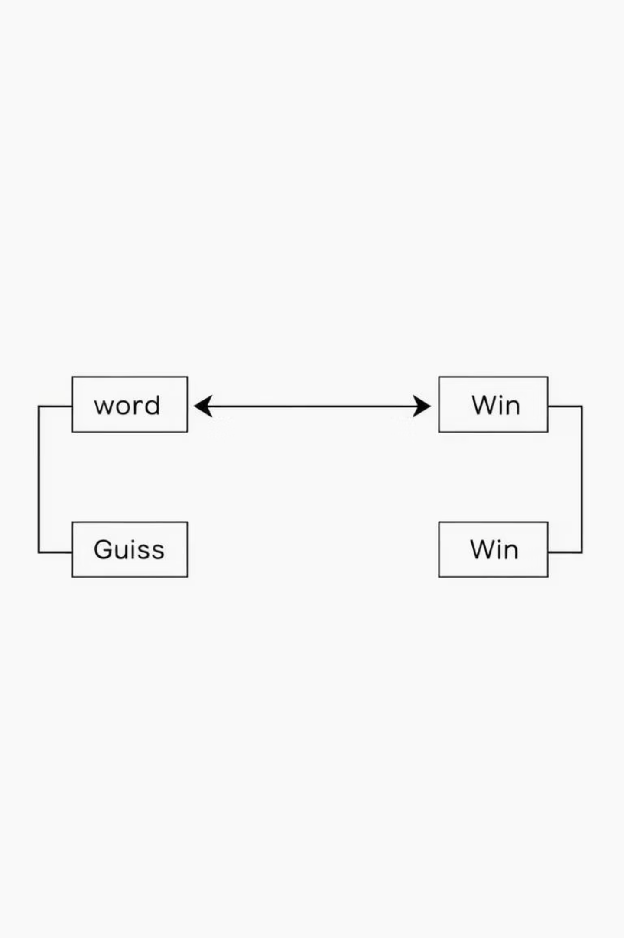




Game Flow
What happens when you play Hangman.
Game Start
Welcome message and rules appear.
Word
Correct?
Win
Word Picked
A secret word is chosen.
Guess
Wrong?
Score!
Guessing Time
You guess letters. The game tells you if you are right or wrong.
Lose ☹
Win or Lose
The game ends. You see if you won or lost.
Group-3 | Members: Intisar Binthay Fauzul, Ashfaqul Alam, Syed Sadat Hasan, Rafiha Saleha

Slide 4
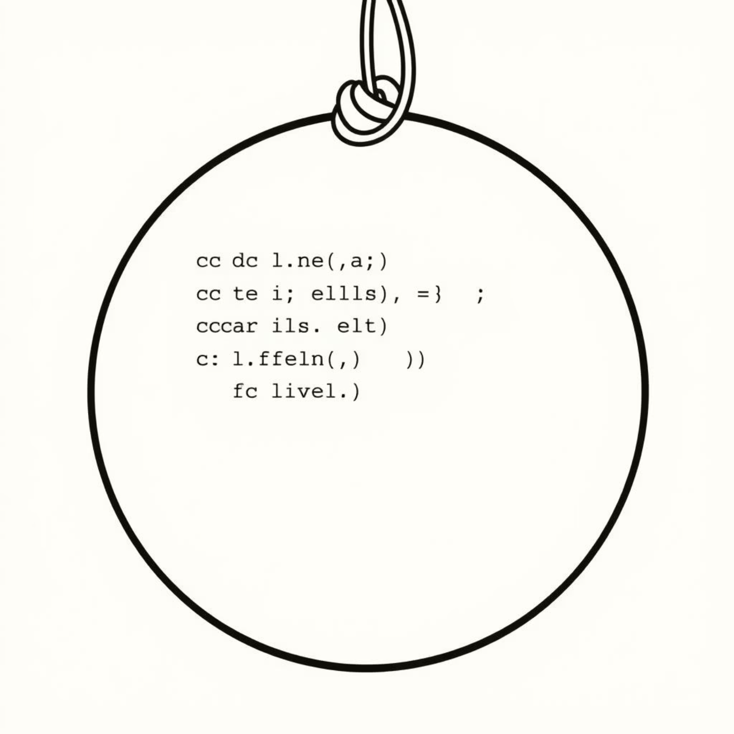
Important Parts of the Game
Many Words
Lots of words to guess from.
Checks What You Type
Makes sure you type real letters.
Hangman Pictures
See the hangman grow as you play.
Remembers Letters
Keeps track of letters you already guessed.
Group-3 | Members: Intisar Binthay Fauzul, Ashfaqul Alam, Syed Sadat Hasan, Rafiha Saleha

Slide 5
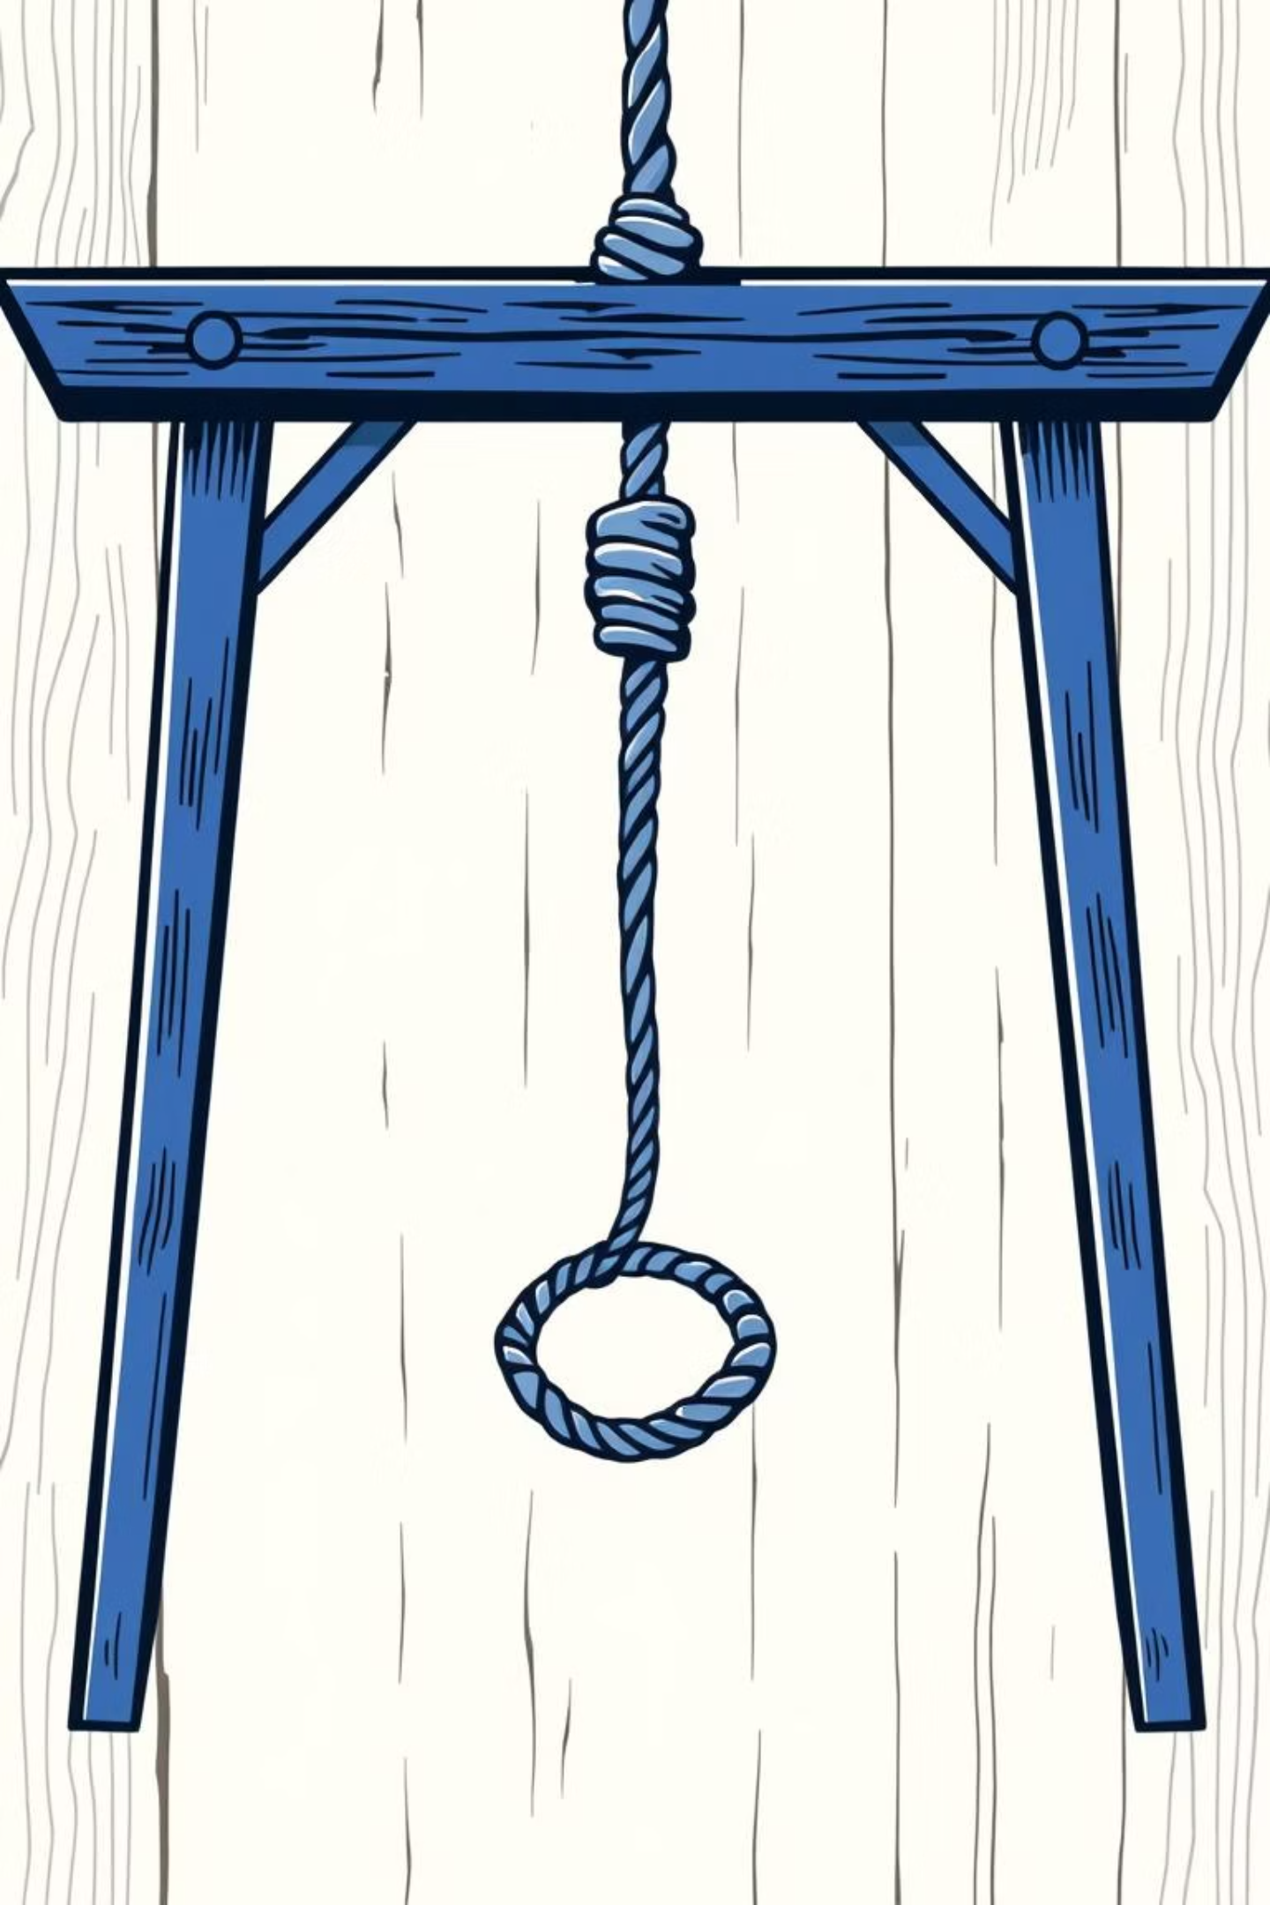



A Journey into Practical Programming
Our goal: To construct a console-based Hangman game in C. This isn't just about building a game, it's an educational pathway to a better understanding of programming concepts and modular software design.
Educates
Engages
Teaches fundamental C programming concepts: strings, arrays, file I/O and crucial memory management techniques.
Provides interactive gameplay with dynamic scoring, high-score tracking and built-in replayability for sustained fun.
Demonstrates
Implements modular software design with clear separation of logic for game mechanics, player data and handling data.
Group-3 | Members: Intisar Binthay Fauzul, Ashfaqul Alam, Syed Sadat Hasan, Rafiha Saleha

Slide 6




Modular Design: The Heart of Our Hangman Architecture
We embraced a modular approach, structuring the project into distinct, manageable components. This design principle ensures easier collaboration.
game.c
Contains all core game logic: word selection, guess processing, visual hangman drawing and win/lose conditions.
player.c
Manages player interactions: name input, secure score saving and loading and high-score display.
main.c
Serves as the controller: controls the overall program flow, integrates the various modules we used and handles the user choices.
Group-3 | Members: Intisar Binthay Fauzul, Ashfaqul Alam, Syed Sadat Hasan, Rafiha Saleha

Slide 7
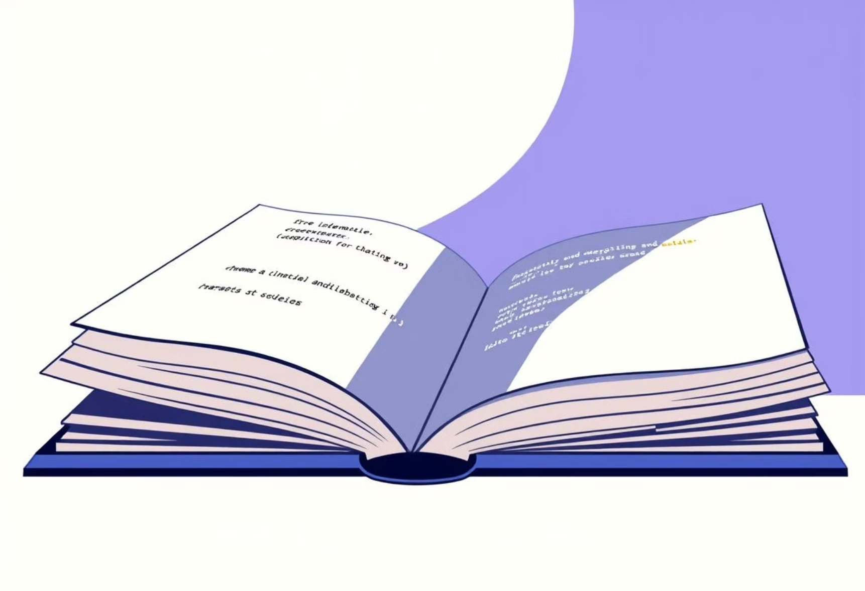

Key Technical Features: Bringing the Game to Life
Our Hangman game integrates several features that enhance its functionality
and user experience.
Dynamic Word Loading
Score Persistence
Words are loaded dynamically
from a words.txt
file, allowing for an
expandable
Vocabulary of over
100 tech-related
terms.
Player scores are saved and
loaded from scores.txt,
ensuring high scores
persist across gaming
sessions.
Interactive User Interface
Robust Memory Management
A basic terminal based UI displays the hangman stages, remaining tries
and a clear list of already guessed
letters for an intuitive experience.
Utilizes malloc and free for efficient word
list handling, preventing memory leaks
and ensuring stable performance.
Group-3 | Members: Intisar Binthay Fauzul, Ashfaqul Alam, Syed Sadat Hasan, Rafiha Saleha

Slide 8
How We Made It
Here's how we built the game...
Plan & Design
1
We decided what the game would do and how it would work.
2
Build Main Parts
We made the game pick words and check guesses.
What Players See
3
We wrote the messages and drew the hangman pictures.
4
Test & Fix
We played the game to find and fix any problems.
Make It Better
5
We made the game easier to understand and more fun to play.
Group-3 | Members: Intisar Binthay Fauzul, Ashfaqul Alam, Syed Sadat Hasan, Rafiha Saleha

Slide 9

Overcoming Challenges: Solutions for a Polished Game
Developing the Hangman game presented various challenges, particularly in user input and resource management. We implemented thoughtful solutions to ensure a stable, user-friendly, and well-structured application.
Challenge: Handling user input errors
Solution: Used fgets() + validation in playerGuess()
Challenge: Managing dynamic word list
Solution: Implemented loadWordsFromFile() with malloc
Challenge: Keeping code modular
Solution: Created separate .h headers for clear interfaces
Group-3 | Members: Intisar Binthay Fauzul, Ashfaqul Alam, Syed Sadat Hasan, Rafiha Saleha

Slide 10
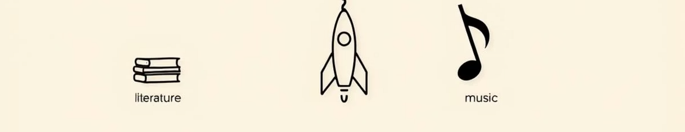
Potential upgrades to the game
Easier or Harder Levels
Word Groups
Change how long words are and how many tries you get.
Play with words about animals, movies, or countries.
Better Pictures
Play with Friends
Move from simple text pictures to real graphics.
One person picks a word, another tries to guess it.
Group-3 | Members: Intisar Binthay Fauzul, Ashfaqul Alam, Syed Sadat Hasan, Rafiha Saleha

